Slide 1
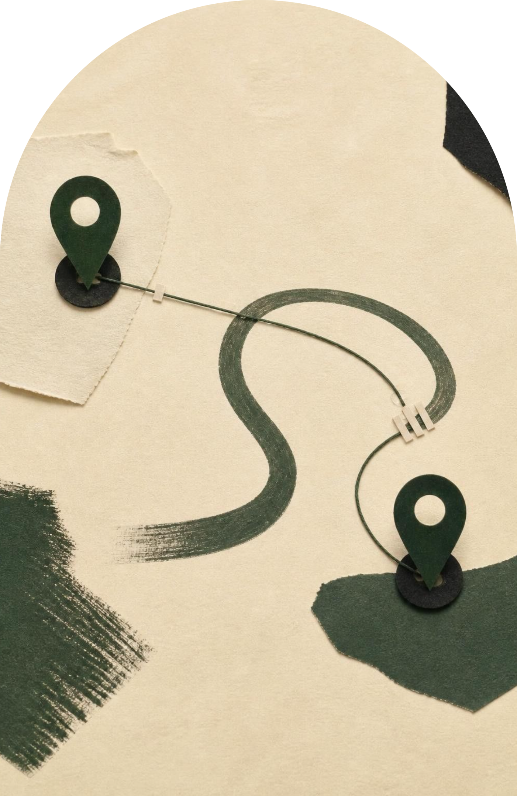
RESEARCH PRESENTATION
Pakistan–Afghanistan
Relations.
Challenges, Security Concerns & Future Prospects
Prepared for World Politics Times · September 2026

Slide 2
CENTRAL ARGUMENT
The relationship is trapped in a security-first cycle.
Interdependence
Geography, history, culture, migration and trade bind the two countries together.
Mistrust
The Durand Line, border management and the TTP issue repeatedly convert interdependence into mistrust.
Way forward
Durable stability requires security cooperation plus diplomacy, humanitarian coordination and regional connectivity.

Slide 3
HISTORICAL LAYERS
Five historical layers still shape today’s crisis.
1893
1979–2001
2021–2026
The Durand Line creates a lasting border dispute.
The Soviet-Afghan War drives refugee flows and deep strategic entanglement.
The Taliban’s return raises expectations, then exposes a widening trust gap.
1
2
3
4
5
1947–79
2001–2021
State formation, Pashtun nationalism and early diplomatic friction.
US intervention, post-2001 militancy and shifting regional alignments.

Slide 4
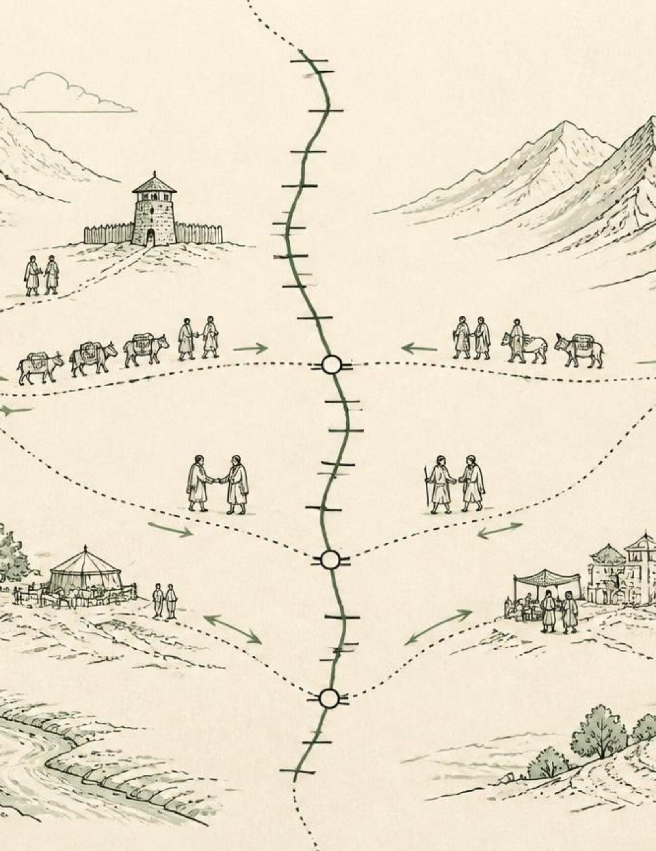
GEOGRAPHY
Shared geography creates both leverage and vulnerability.
More than 2,600 kilometres: shared border connect Pakistan’s Khyber Pakhtunkhwa and Balochistan with Afghan provinces.
Communities share languages, tribal and family ties, religious traditions and trade routes.
Pakistan prioritises: border security, militant containment, refugee management and access to Central Asian markets.
Afghanistan prioritises: sovereignty, movement, trade access and freedom from external pressure.

Slide 5
BORDER MANAGEMENT
The Durand Line turns border management into a political test.
01
02
03
04
Inherited border
Controls
Immediate costs
Stabilisers
Pakistan treats the international border as settled; Afghan positions have historically challenged its legitimacy.
Fencing, controlled crossings and closures can reduce illegal movement but also trigger confrontation.
At Torkham and Chaman, security decisions affect traders, families, patients, transporters and refugees.
Documented crossings, biometric systems, coordinated patrols, customs cooperation and a permanent border hotline.

Slide 6




SECURITY DILEMMA
The TTP dispute is a classic security dilemma.
Militant attack
Accusation
Pakistan says attacks on its territory are enabled from Afghan soil.
1
Pakistan demands concrete action against the TTP.
2
Border tension → military response → deeper mistrust
Denial
Afghanistan resists Pakistani military action inside Afghanistan. Each side’s security measure is read by the other as a threat.
4
Afghan authorities reject deliberate sanctuary claims.
3

Slide 7
2026 EVIDENCE
146
HUMANITARIAN CRISIS
2026 showed how quickly a bilateral dispute can become a humanitarian crisis.
civilian casualties in Afghanistan
UNAMA · 26 February–2 March 2026
42 deaths were included in the reported total.
Pakistan and Afghan forces engaged in some of the most severe fighting between the neighbours since 2021.
Airstrikes, military responses, border closures and displacement disrupted civilian life and commerce.
Chinese mediation and subsequent talks showed that both sides still need a diplomatic off-ramp.

Slide 8
RESPONSIBILITY AND PRESSURE
Refugees sit at the intersection of responsibility and pressure.
PAKISTAN’S POSITION
PROTECTION NEEDS
More than four decades of hosting
1.42 million at end-2025
Pakistan has hosted Afghan refugees for more than four decades. It cites security, administrative and economic constraints.
Approximately 1.42 million Afghan refugees and other Afghans needing international protection were in Pakistan at the end of 2025.
Durable framework: documentation, voluntary return, international assistance, resettlement and reintegration.
Humanitarian organisations stress protection, family unity, education and healthcare.

Slide 9
ECONOMIC INTERDEPENDENCE
Trade is the clearest unrealised dividend of interdependence.
Arabian Sea
19% → 14%
Pakistan offers Afghanistan a route to the Arabian Sea and international maritime markets.
Afghanistan’s share of imports from Pakistan fell from 19% in 2023 to 14% in 2024.
Border friction
Border closures and political friction push trade toward alternative routes, including Iran.
Connectivity
Digital customs, predictable crossings, transit agreements, logistics, energy and Central Asian connectivity could make interdependence stabilising.

Slide 10
REGIONAL STAKES
Regional powers widen the stakes beyond the border.
Actor | Primary stake | Relationship effect
China | Stability, Xinjiang security, economic corridors and mediation. | Creates incentives for de-escalation and regional connectivity.
Iran | Alternative trade and transit routes. | Gains relevance as Pakistan corridors become less reliable.
India | Development and humanitarian engagement. | Viewed in Pakistan through strategic rivalry.
United States | Counterterrorism, humanitarian concerns and preventing transnational militant safe havens. | Keeps the relationship tied to wider security concerns.

