Slide 1
SECURITY BRIEFING
Pakistan’s Geopolitical
and Military Security
A policy view of geography, escalation, water, internal threats, defence posture, partnerships and economic resilience.
Strategic assessment · 2025 crisis context

Slide 2





01 · GEOGRAPHY
Pakistan’s location creates leverage and exposure
Pakistan sits between South Asia, Central Asia, the Middle East, western China and the Arabian Sea.
Strategic access
Recurring pressure points
Connectivity as security
Its borders with India, Afghanistan, Iran and China create strategic access.
The same borders also create recurring pressure points.
Gwadar, CPEC and maritime routes make connectivity a security issue as much as an economic opportunity.
Gwadar Hub
Regional Connect
Maritime gateway on Arabian Sea
Access to South & Central Asia
CPEC Corridor
Pressure Points
Overland link to western China
India, Afghanistan, Iran, China
02

Slide 3
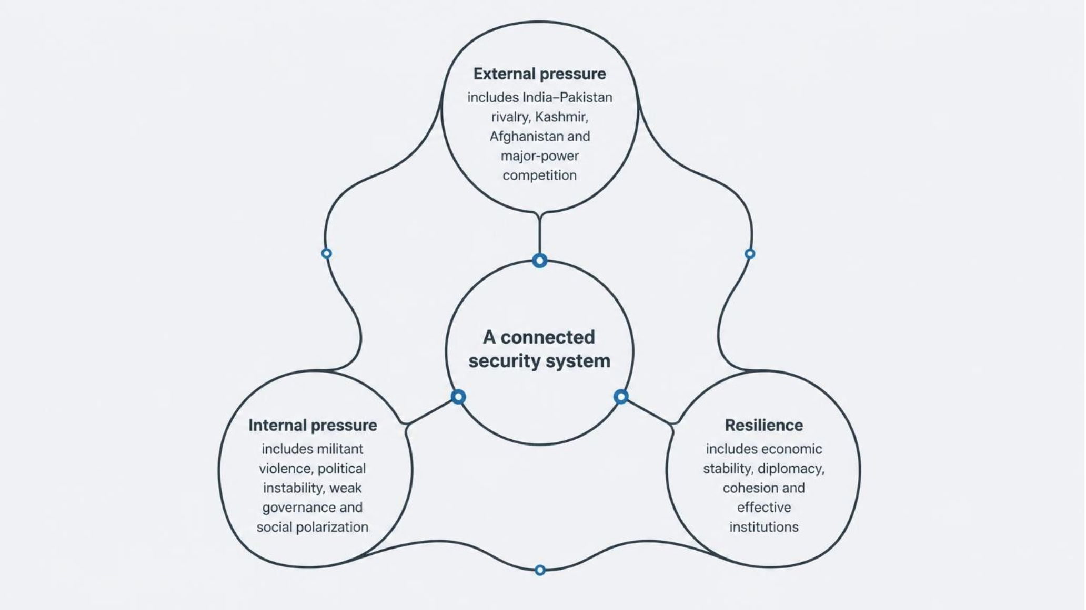
02 · SYSTEM
Security is a connected system, not a single military problem
Defence capability must be reinforced by economic stability, diplomacy, cohesion and effective institutions.
03

Slide 4
03 · INDIA–PAKISTAN RIVALRY
The India–Pakistan rivalry keeps escalation close
Kashmir remains central
Escalation stays close
Deterrence is not certainty
Territorial claims, military deployment, political representation, water and identity combine in one dispute.
The Line of Control remains heavily militarized. Ceasefire violations, militant attacks and political decisions can rapidly raise tensions.
Nuclear deterrence reduces the risk of total war, but does not remove limited conflict or miscalculation.
04

Slide 5
04 · MAY 2025 CRISIS
The May 2025 crisis showed how fast a nuclear rivalry can escalate
22 April
7–10 May
Ceasefire
The crisis followed the 22 April 2025 Pahalgam attack, in which 26 people were killed.
Military exchanges from 7 to 10 May involved air strikes, fighter aircraft, missiles, drones, air defence and artillery.
The ceasefire lowered immediate risk but left Kashmir, water-sharing, militancy, mistrust and information warfare unresolved.
05

Slide 6

05 · WATER SECURITY
Water security has become strategic security
The Indus Basin is a strategic system
Climate-resilient agriculture
External water diplomacy
Drought-tolerant crops and practices
Negotiations with neighbouring states
The 1960 Indus Waters Treaty allocated the eastern rivers primarily to India and the western rivers primarily to Pakistan, with defined cooperation and dispute mechanisms.
The basin underpins agriculture, irrigation, food security, hydropower, drinking water and industry.
Storage infrastructure
Reservoirs and groundwater recharge
1960 Indus Waters Treaty
Pakistan's Water Security
Framework for river allocations
Conservation measures
Irrigation efficiency
Demand management and reuse
Modernize canals and delivery
06
Pakistan needs both external water diplomacy and domestic reform.

Slide 7
06 · INTERNAL THREATS
Internal threats require different tools for different groups
TTP
BLA
Durable stability
Militant Islamist violence linked to attacks, cross-border movement and insecurity along the Afghanistan border.
Separatist militancy in Balochistan targeting security forces, infrastructure, foreign nationals and CPEC-related projects.
Operations matter, but stability also depends on political dialogue, public services, rights, local participation and trusted institutions.
07

Slide 8
07 · DEFENCE POSTURE
01
Pakistan’s defence posture spans deterrence, counterterrorism and the sea
Force architecture. The Army, Air Force, Navy, air-defence systems, missile forces and intelligence institutions serve overlapping defence and internal-security roles.
Overlapping capabilities serve overlapping security roles.
02
Modern battlefields. The 2025 crisis underlined the importance of airpower, surveillance, electronic warfare, drones and situational awareness.
03
Strategic restraint. Nuclear deterrence requires secure command and control, risk reduction, strategic communication and restraint.
08

Slide 9
08 · PARTNERSHIPS
Partnerships widen Pakistan’s options, but do not replace self-reliance
China
United States
Wider channels
Defence cooperation, CPEC, infrastructure, energy and technology links.
A pragmatic partner across defence, counterterrorism, diplomacy, trade and development, despite recurring strategic disagreements.
Turkey, Iran and multilateral forums add defence, border, trade, energy and diplomatic channels.
09

Slide 10
09 · ECONOMIC RESILIENCE
Economic resilience sets the ceiling for military security
Military security depends on the fiscal, industrial and social capacity that sustains it.
01
02
03
Protect readiness
Protect investment
Build resilience
Fiscal pressure, debt, inflation, energy shortages and foreign-exchange constraints can limit procurement, modernization and readiness.
Ports, highways, energy projects, digital infrastructure, foreign workers and CPEC assets require protection.
Education, health, employment, exports and industrial capacity are security investments because they strengthen national resilience.
10

